Slide 1
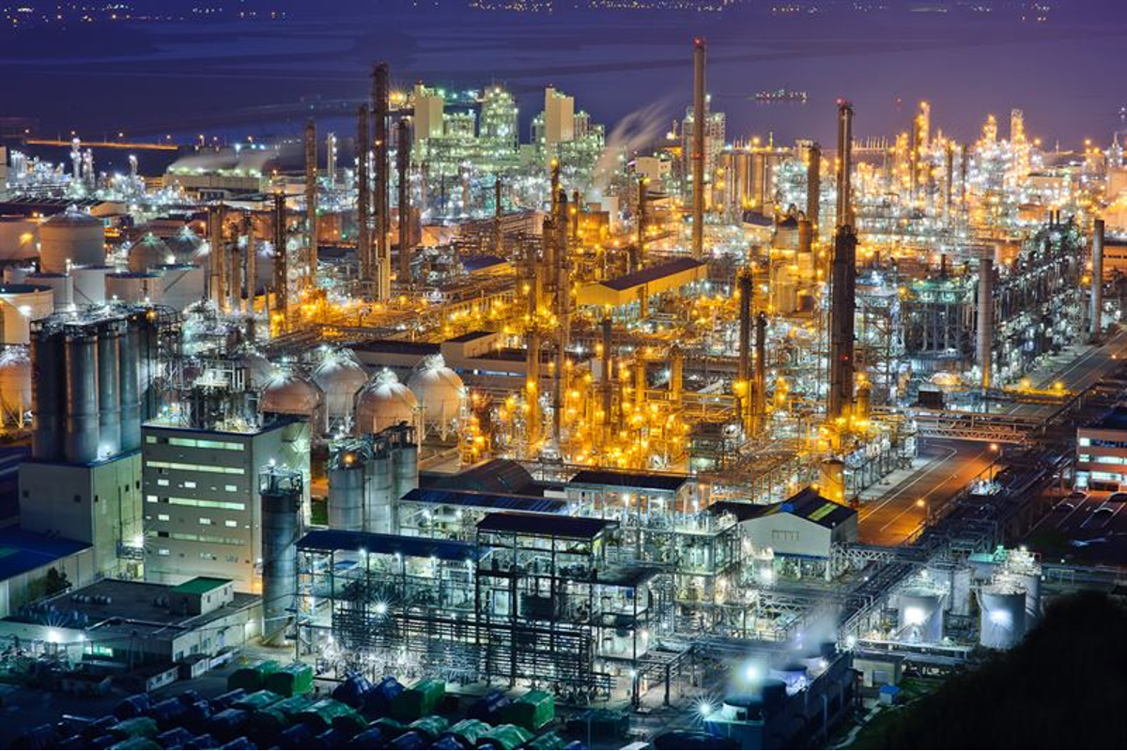
Purchase Decision Model for Centrifugal Gas Compressors
Ryo Kudo
Wookjin Lee
Kwang Chul Park
Katz Graduate School of Business

Slide 2
Background
Petrochemical company employee
The subject is one of the real decisions in real work.
Centrifugal Gas Compressor
LG Chem’s petrochemical complex in South Korea

Slide 3
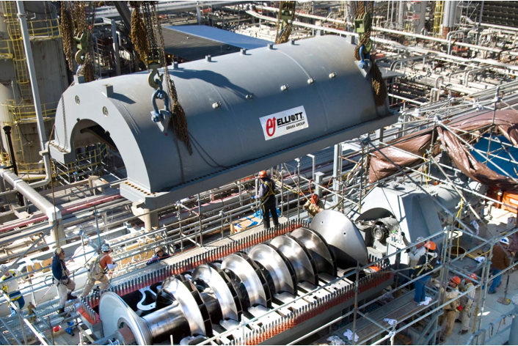
Centrifugal Gas Compressors
Various manufacturers
Diverse features
Expensive
Purchase based on intuition
Want to make purchasing more systematic

Slide 4
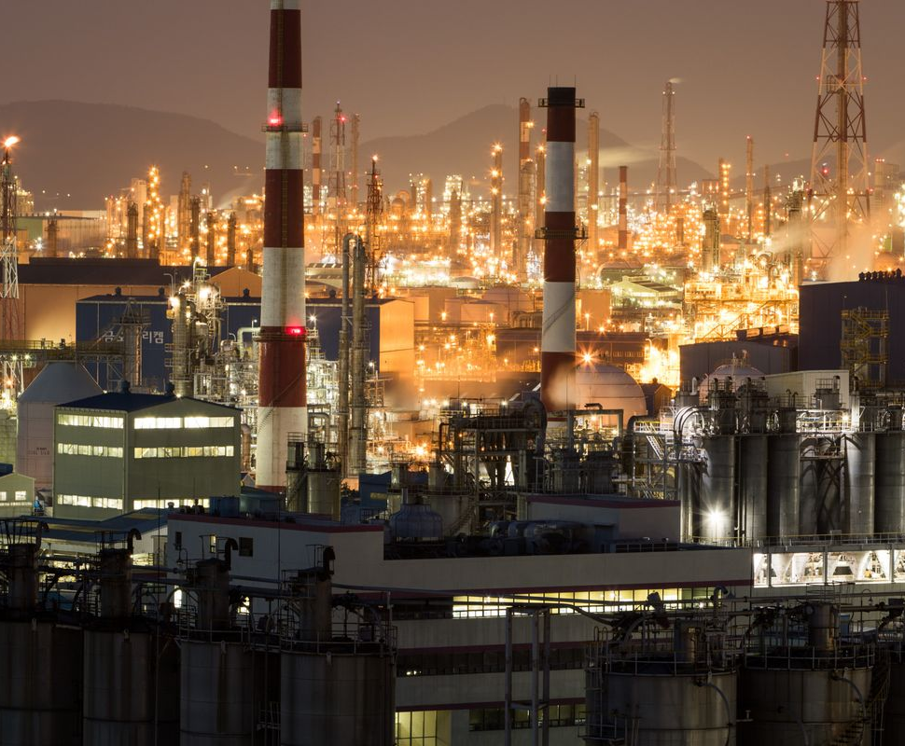
Our Approach
AHP & Rating
Prioritize centrifugal compressors with AHP and rating models.
Resource Allocation
Create a resource allocation model to make decisions about which to buy within a limited budget.
Systematic Purchasing
Achieve systematic purchasing.

Slide 5
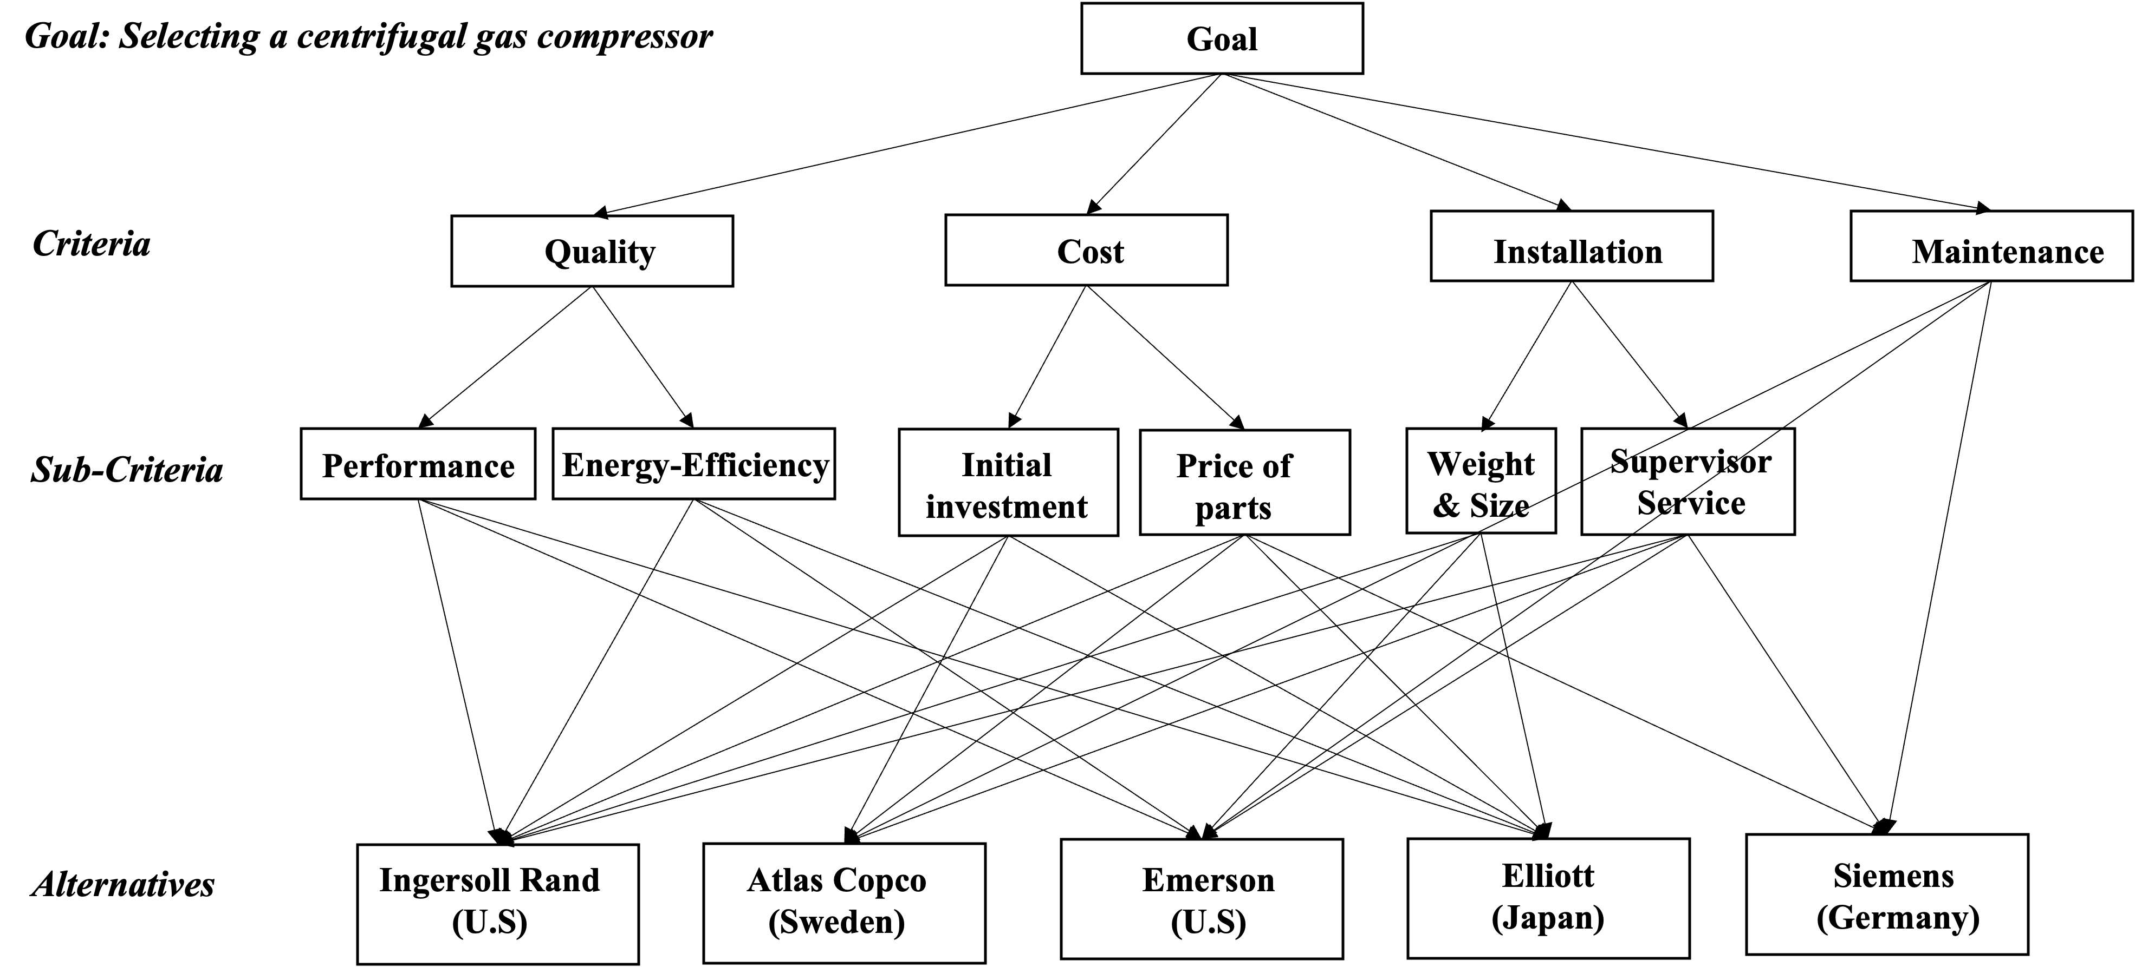
AHP - Modeling
Notes:
MEMO:
Explain how we determined Alternatives and Criteria!

Slide 6
Weights
Overall Weights
Relative Evaluation of Criteria
An example of Sub Criteria: Performance
Notes:
MEMO: Give a concrete example of how we determined the weights!

Slide 7
Rating
Rated with a mix of
3 and 5-level grading
Notes:
MEMO:
Give a concrete example of how we determined the value!

Slide 8
■ Blue = Good Rating
■ Orange = Bad Rating
Rating Results
Notes:
Here is the final results of the ratings. In this table, blue represents good ratings and orange represents bad ratings.
We can see, Ingersoll Rand and Atlas Copco have good ratings on average. Especially, Ingersoll Rand has many blue cells.
However, Emerson, Elliott, and Siemens received some good ratings but also a few bad ratings.
e.g., Emerson got the highest ratings for three criteria, but also got the lowest rating for its large initial investment.
And then, we evaluated the weights of criteria , and arrived at the following final results.

Slide 9
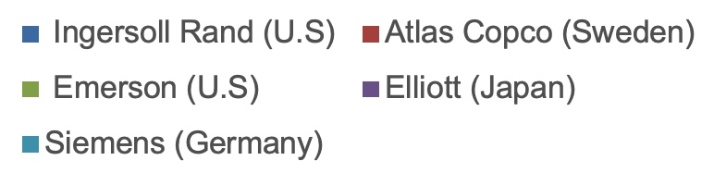
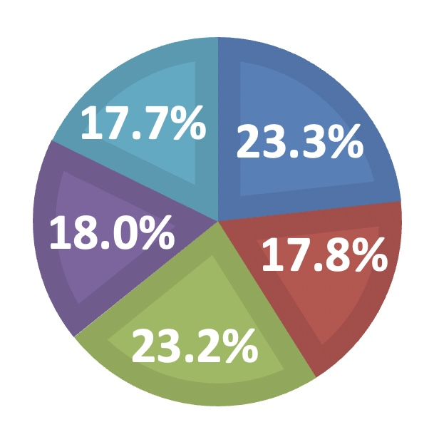
Synthesis Result
Ingersoll Rand was the top.
Notes:
This is the result.
Ingersoll Rand was the top priority.
Emerson did a good fight with many strengths, but did not get on the top because of the high weight of its weakness, the large initial investment.
And, There is little difference of the other options.

Slide 10
Resource Allocation & Results
Budget: $10,000,000
Purchasing one Ingersoll Rand is optimal.
Notes:
Finally, if we had a budget of $10 million dollars, which and how many compressors we should buy? This is a kind of resource allocation problem. So we calculated it.
We found that/ buying one Ingersoll Rand compressor was the optimal solution, in this case.
That is what we did for our final project.

Slide 11
Conclusions
WHAT THE MODEL BROUGHT
Got a Systematic Model
Good for Visualizing
How to Improve
AHP is a very good method for visualizing and sharing know-how of Decision Making with others.
By taking much time to discuss Alternatives and Criteria, we can create a better model that reflects everyone's will.
We got a good decision model for purchasing compressors.
Notes:
We got a model to buy the best compressors. We were able to put information about our options and criteria, into our model.
we found that these models are excellent to show others how we thought, and came to certain conclusions.
(For example, I knew nothing about this Gas Compressor, but after getting the base model created by Kwang Chul, I easily understood what sort of things he was focusing on/ when making decisions. )
I think that is really good effect of AHP modeling.
And, if we can talk to more people about Alternatives, Criteria, and so on, we can get more objective models.

Slide 12
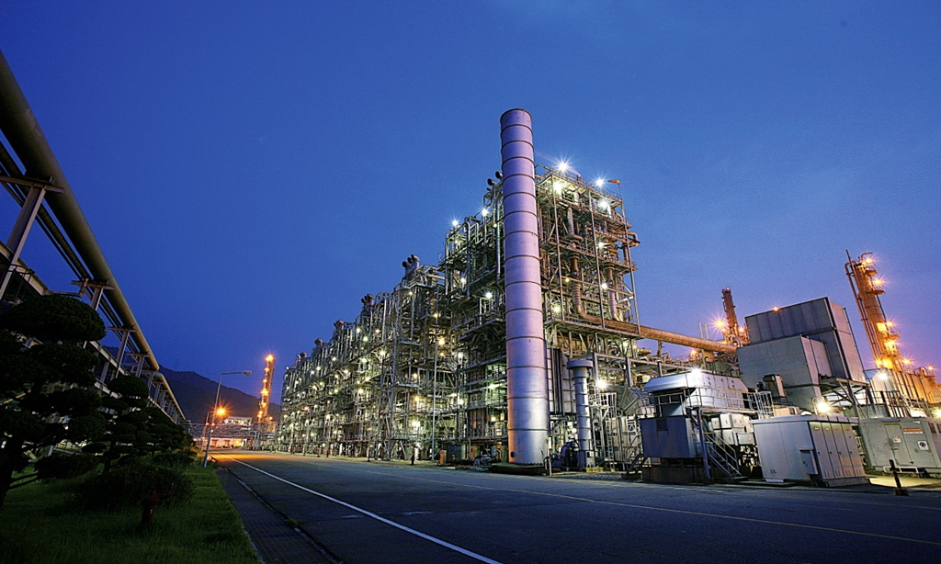
THANK YOU!

